Slide 1
Compiler Design
Code Analyzer project
Sohrab Namazinia
School of Computer Engineering,
Iran University of Science & Technology
Winter 2021

Slide 2
Code Analyzer | Introduction
We want to code a python project, which takes a java project as input, parses its java files, does something in their listeners and creates an analysis text file as output.
Analysis consists of getting all the java files names, all the classes names, each class fields, each class methods, each fields access modifier, each method access modifier, number of private fields, public fields, private methods, public methods, etc.
In the next slides, we will explain how to do it step by step.

Slide 3
Code Analyzer | Folders
First of all, we create a grammar folder in the project and put the java grammar files for lexer and parser in.
Then we configure antlr for them and generate the python listener, etc files.
Also we create an output folder in project so that it would be the path that our result text file will be created in.
Then we create a test_project folder that will contains the project that we want to analyze it.
The next creating folder is src, in src folder we create our main python file so that we will run it to get the result.
And the final folder is utils, which contains our necessary python files that we will need to create.

Slide 4
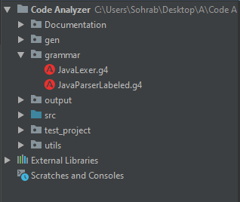
Code Analyzer | Folders
Here is the structure of the project, now it is time to write the code

Slide 5
Code Analyzer | get java files
First thing we need to do is to get all the java files of the input test project so that we parse them. for that, we create a get_java_files python file in utils directory.
In this file, we create a get files method which takes a string path as input which is the root of the project.
In this method, we walk the directory and return a list containing all the files of the project which ends with “java” independent of lower or upper case.

Slide 6
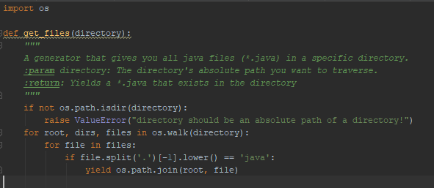
Code Analyzer | get java files
Here is the get_java_files.py file in utils directory:

Slide 7
Code Analyzer | listener
Now in utils folder, we create a python file called code_analyzer_listener.py. In this file, we override our created listener in gen folder so that we take necessary actions in that.
Actions must be done in four cases:
Constructor of the listener
Enter class declaration of the listener
Exit field declaration
Exit method declaration

Slide 8
Code Analyzer | listener (constructor)
In constructor of the listener, we need to define our data structure:
An empty list “class_names” which will store all classes names.
Current_class_name = None, this attribute will hold the name of the class which parser is in while doing DFS.
2 dictioanries: classes_fields, classes_methods. Their keys are the name of the classes and the values are the fields/methods of those classes.
Now we are ready to override the necessary listener methods.

Slide 9
Code Analyzer | listener (constructor)
In constructor of the listener, we need to define our data structure:
An empty list “class_names” which will store all classes names.
Current_class_name = None, this attribute will hold the name of the class which parser is in while doing DFS.
2 dictioanries: classes_fields, classes_methods. Their keys are the name of the classes and the values are the fields/methods of those classes with their access modifiers.
Now we are ready to override the necessary listener methods.

Slide 10
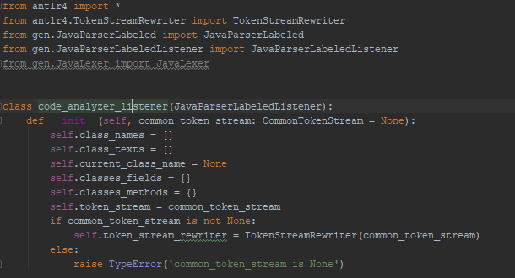
Code Analyzer | listener (constructor)
Here are the necessary imports, listener declaration and its constructor:

Slide 11
Code Analyzer | listener (enter class)
Now we override enterClassDeclaration method which is called when we enter a class.
In this method, we get the class name and append it to class names.
Also we set the classes_fields[class_name] = [] and the same for methods dictionary so that they become initialized.
Also the most important thing here is to set the current_class_name equal to the class name so that later we know where we are.

Slide 12
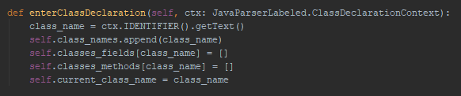
Code Analyzer | listener (enter class)
Here is the contents of enterClassDeclaration:

Slide 13
Code Analyzer | listener (exit field)
Now time to override exitFieldDeclaration method.
In this method, we also want to check if the field is public, private or none of them. so first we define access_mod = None
In this case, the access modifier is the parent of parent of the current context, so we check it starts with public, we set access_mod to public, if private, we do the same thing, else, we keep this variable as None
Also we need to get the field name, which is in context.variableDeclarators().getText(). But it we have a field like “public a=10”, this will give us a=10 as the field, so we need to split the result by “=“ and get the first part of that.
Now we just need to add the field name in the classes fields dictionary. The key is the current class name, the value is a tuple of (field_name, access_mod)

Slide 14
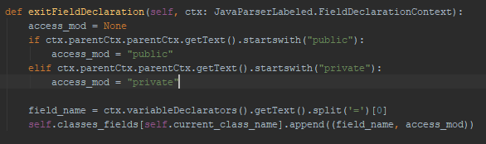
Code Analyzer | listener (exit field)
Here is the exitFieldDeclaration method body:

Slide 15
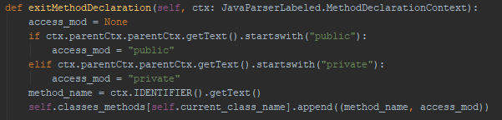
Code Analyzer | listener (exit method)
We override exitMethodDeclaration and do the same process as field too. Here is the code for it:
Hopefully we have completed our listener which is the most important part!

Slide 16
Code Analyzer | main file
Now in src folder, we create main.py file so that we use our listener in that.
First, we get the java files of the test_project folder which contains a test project (for example chess-master). For each file, we get the java file name and append it to java files list.
For each java file, we create the token stream, lexer, parser and our listener. We walk its parse tree, then we have the right values in the fields of our listener. For each class in class name, we fetch its fields and methods with their access modifiers.
Also we do for loops to get the number of private fields, private methods, etc.
Finally we write the results in an output file called “analysis.txt” in output folder.

Slide 17
Code Analyzer | main file
Here is the main file code:
from antlr4 import FileStream
from gen.JavaLexer import JavaLexer, CommonTokenStream, ParseTreeWalker
from gen.JavaParserLabeled import JavaParserLabeled
from utils.code_analyzer_listener import code_analyzer_listener
from utils.get_java_files import get_files
def main():
java_files = get_files("../test_project")
classes_fields = {}
classes_methods = {}
java_file_names = []
for file in java_files:
file_name = (file.split('\\')[-1]).split('java')[0][0:-1]
java_file_names.append(file_name)

Slide 18
Code Analyzer | main file
try:
stream = FileStream(file)
except UnicodeDecodeError:
print("This file can not be decoded:\n" + file + "\n")
return
lexer = JavaLexer(stream)
tokens = CommonTokenStream(lexer)
Parser = JavaParserLabeled(tokens)
tree = Parser.compilationUnit()
listener = code_analyzer_listener(lexer)
walker = ParseTreeWalker()
walker.walk(listener=listener, t=tree)

Slide 19
Code Analyzer | main file
for cl in listener.class_names:
classes_fields[cl] = []
classes_methods[cl] = []
for var in listener.classes_fields[cl]:
classes_fields[cl].append(var)
for method in listener.classes_methods[cl]:
classes_methods[cl].append(method)
private_field_count = 0
public_field_count = 0
private_method_count = 0
public_method_count = 0

Slide 20
Code Analyzer | main file
for cl in classes_fields:
for name, mod in classes_fields[cl]:
if mod == "public":
public_field_count += 1
elif mod == "private":
private_field_count += 1
for cl in classes_methods:
for name, mod in classes_fields[cl]:
if mod == "public":
public_method_count += 1
elif mod == "private":
private_method_count += 1

Slide 21
Code Analyzer | main file
output = open("../output/Analysis.txt", "w+")
output.write("Analysis completed successfully!\n\n")
output.write("Number of Java files: " + str(len(java_file_names)) + "\n")
output.write("Number of java classes: " + str(len(classes_fields)) + "\n")
output.write("Total number of fields: " + str(private_field_count + public_field_count) + "\n")
output.write("Total number of private fields: " + str(private_field_count) + "\n")
output.write("Total number of public fields: " + str(public_field_count) + "\n")
output.write("Total number of methods: " + str(public_method_count + private_method_count) + "\n")
output.write("Total number of private methods: " + str(private_method_count) + "\n")
output.write("Total number of public methods: " + str(public_method_count) + "\n\n")

Slide 22
Code Analyzer | main file
output.write("Java files names:\n\t")
i = 0
for java_file_name in java_file_names:
output.write(java_file_name + "\n")
i += 1
if i != len(java_file_names):
output.write("\t")
output.write("\nJava classes Fields:\n\t")

Slide 23
Code Analyzer | main file
for cl in classes_fields:
output.write("Class name: " + cl + "\n\t\t")
output.write("Number of fields: " + str(len(classes_fields[cl])) + "\n\t\t")
output.write("Class fields:\n\t\t")
i = 0
for name, mod in classes_fields[cl]:
if mod is not None:
output.write(name + " (Modifier = " + mod + ")\n\t")
else:
output.write(name + "\n\t")
i += 1
if i != len(classes_fields[cl]):
output.write("\t")

Slide 24
Code Analyzer | main file
output.write("\n\nJava classes Methods:\n\t")
for cl in classes_fields:
output.write("Class name: " + cl + "\n\t\t")
output.write("Number of methods: " + str(len(classes_methods[cl])) + "\n\t\t")
output.write("Class methods:\n\t\t")
i = 0
for name, mod in classes_methods[cl]:
if mod is not None:
output.write(name + " (Modifier = " + mod + ")\n\t")
else:
output.write(name + "\n\t")
i += 1
if i != len(classes_methods[cl]):
output.write("\t")

Slide 25
Code Analyzer | main file
if __name__ == '__main__':
main()
so now we just run the main file, and “analysis.txt” will be created in output folder.
In the next slide, you can see the format of analysis file for an input test project.

Slide 26
Code Analyzer | main file
if __name__ == '__main__':
main()
so now we just run the main file, and “analysis.txt” will be created in output folder.
In the next slide, you can see the format of analysis file for an input test project.

Slide 27
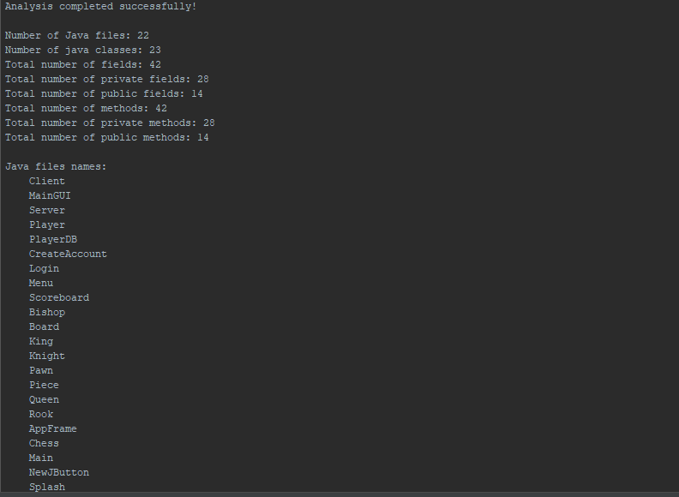
Code Analyzer | result

Slide 28
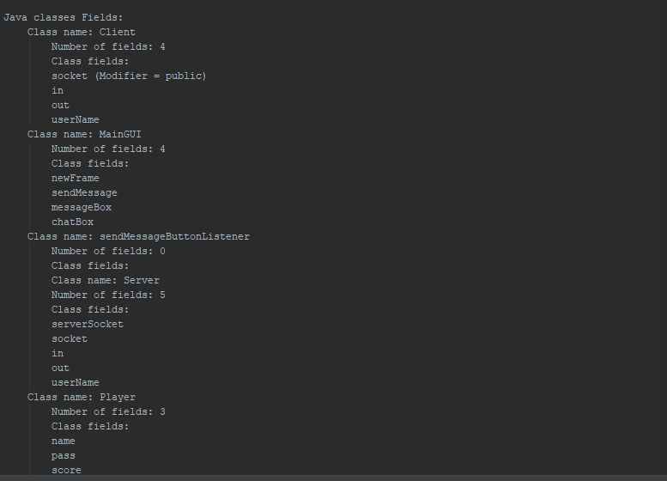
Code Analyzer | result

Slide 29
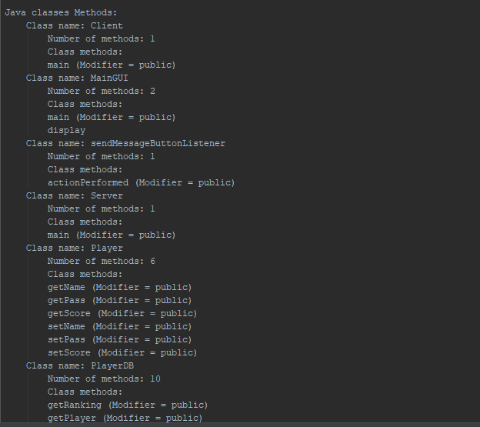
Code Analyzer | result

